Slide 1

Secure Messenger
Under the guidance of: Prof. Ishawari Raskar
Presented by:
MITU21BTIT0042 Omkar Rasal.
MITU21BTIT0005 Ajinkya Sathe.
MITU21BTIT0061 Tanvi Bodke.
MITU21BTIT0048 Prathamesh Panchmire.

Slide 2

CONTENTS
Introduction
Problem Statement
Objective
Concepts & Methods
Literature Survey
Tools & Languages
Process & Architecture
Implementation
Results
Conclusion & Future work
References

Slide 3
INTRODUCTION
Secure messenger is a source and medium of communication that, if packaged in a practical and sophisticated way, will be able to provide solutions to the security of communication media as well as to supply impetus for user’s interest and safety outcomes. Secure Messenger is two-way chatting application with features of high level Encryption – Decryption. This application is secured as it uses chat Encryption-Decryption using Cryptography Algorithms. Also this application allows users to communicate over cloud environment.
You could enter here a subtitle if you need it

Slide 4
PROBLEM STATEMENT
In today’s increasing technology there are several applications which provides a digital platform for communication but didn’t provide the security for our data as well as for our personal details.
Also, there is a problem related to storage consumption as many of the applications are storage consuming and it causes unnecessary flooding of files in our device which cause to lack of storage space and may have to use third party applications to storage that junk on the cloud.
Many times, the device got stolen and user is unable to recover the data as well as when device got stolen, users are unable to logout their accounts from the previous devices. So, by considering all these problems we have come up with a solution named as Secure Messenger.

Slide 5
OBJECTIVE
01
To develop an application which will assures security and integrity of data.
02
Get to know more about how cryptography takes place.
03
To work on Realtime database.

Slide 6
CONCEPTS & METHODS
METHOD
CONCEPT
Encryption is the process of converting information or data into an indecipherable code while in transit or storage.
This prevents any unauthorized access from malicious third-parties and keeps your personal information under lock and key.
Symmetric key Encryption:
Requires only single key for both Encryption & Decryption.
Asymmetric key Encryption:
It requires two keys, a public key and a private key, one to encrypt and the other one to decrypt.

Slide 7
LITERATURE SURVEY
Journal Publication | Key points
Hindawi | Users can store their data remotely in the cloud.
Clinical Engineering | Cryptography is a term which refers to molecules in storing, hiding, and transmitting the information.
MDPI | Existing data protection and encryption techniques have been analyzed.

Slide 8


TOOLS & LANGUAGES
  Android Studio
  Realtime database
  Cloud database
  Firebase_Auth
  Firebase_Core
  Cloud_Firestore
  Shared Preference
  Image Picker
  Encrypt
Languages & Dependencies
Tools and Services

Slide 9





IMPLEMENTATION
Using Firebase Real Time Database to store Personal Details.
Fragments to display Chats and Users.
Authentication using Firebase
Cryptography Algorithms such as AES
Auto Login/ Logout Using Firebase.

Slide 10
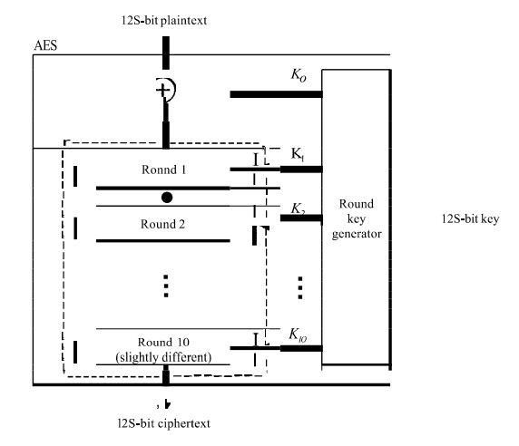
PROCESS & ARCHITECTURE
AES ALGORITHM

Slide 11
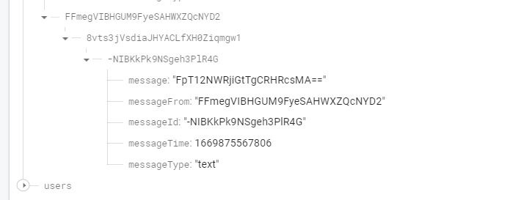
IMPLEMENTATION
FIREBASE SS

Slide 12
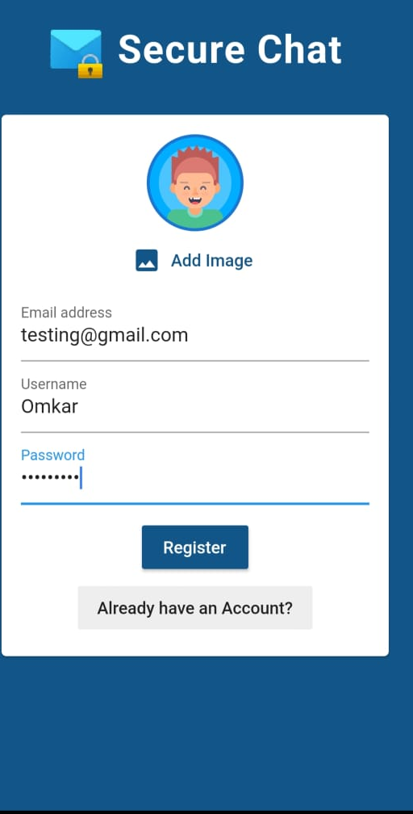
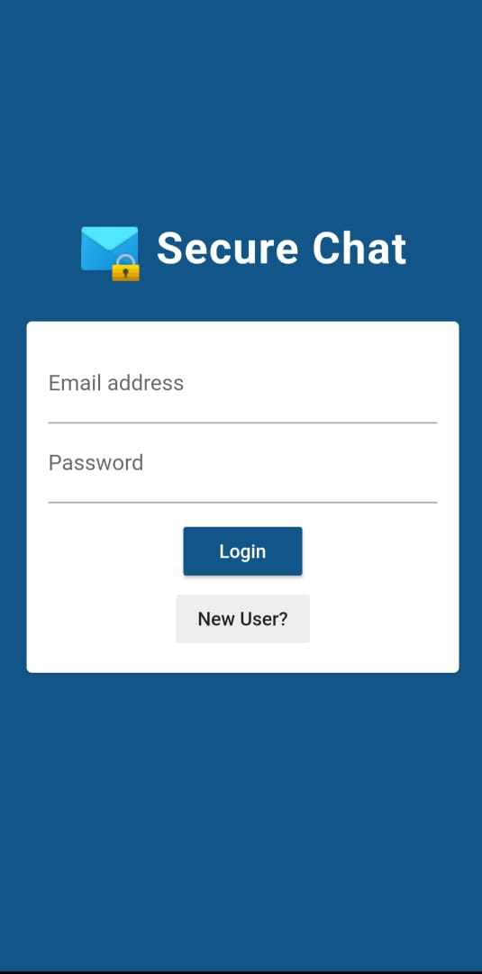
RESULTS

Slide 13
CONCLUSION & FUTURE WORK
It is an essential app to have on smartphone for those who are considering privacy as their first priority. It will be a secure messaging application that lets users allow to communicate over secured cloud environment. It will also give you the ability of sending and accepting request. The application will also be able to keep users’ personal information secure. This can be very helpful in terms of privacy.

Slide 14

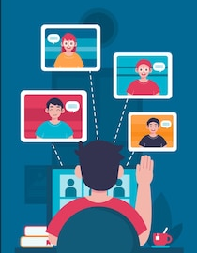
FUTURE WORK
FILE SHARING
CONFERENCE CALLS / VIDEO CALLS

Slide 15
REFERENCES
01
https://journals.lww.com/jcejournal/Abstract/2022/04000/Review_of_Advanced_Techniques_for_Data_Security.10.aspx?context=LatestArticles
02
https://www.hindawi.com/journals/cin/2022/8303504/
03
https://www.mdpi.com/2073-8994/14/4/695

Slide 16
THANK YOU!

Slide 17
Questions

